Slide 1

Seeing Cities Through Statistics
Pete Rodrigue
Kenyon College

Slide 2
Assumptions

Slide 4
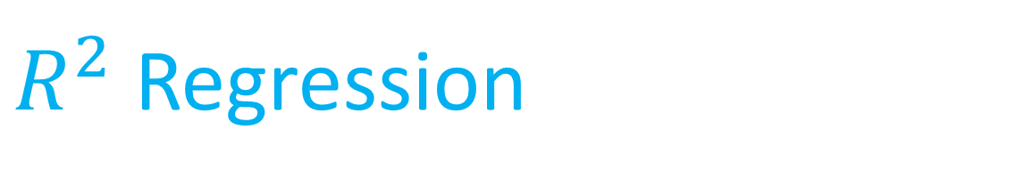
$R^{2}$ Regression

Slide 5
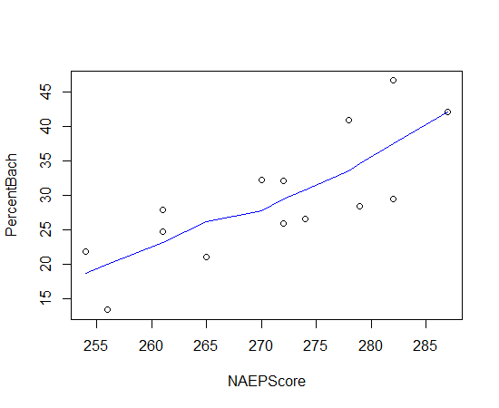
Lowess Regression

Slide 8
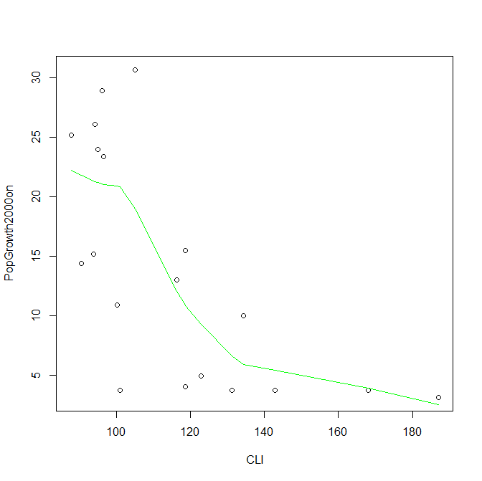
Lowess Regression

Slide 12

Jonckheere-Terpstra Tests
$$τ_{south}=τ_{midwest}≤τ_{west}=τ_{north}$$

Slide 13
J = 188.5, p-value = 1.736e-05
alternative hypothesis: South > Midwest > West > Northeast

